Slide 1
Management Stephen P. Robbins | Mary Coulter
Chapter 1A Management History Module

Slide 2
Learning Objectives
Describe some early management examples.
Explain the various theories in the classical approach.
Discuss the development and uses of the behavioral approach.
Describe the quantitative approach.
Explain the various theories in the contemporary approach.
© Pearson Education Limited 2016

Slide 3
Early Management
3000 BC – 1776

Slide 4


Early Examples of Management
Management has been practiced a long time.
The Egyptian pyramids
Took more than 100,000 workers and some 20 years to construct a single pyramid.
The Great Wall of China
Recognized as one of the most impressive architectural feats in history.
© Pearson Education Limited 2016

Slide 5
Division of Labor (Job Specialization)
In 1776, Adam Smith published The Wealth of Nations
Division of Labor – breaking down jobs into narrow and repetitive tasks
Increase productivity
save time lost in changing tasks
creating labor-saving inventions and machinery
© Pearson Education Limited 2016

Slide 6
Industrial Revolution
In the Late 18th Century machine power was substituted for human power
It became more economical to manufacture goods in factories rather than at home
These factories needed someone:
to forecast demand
ensure that enough material was on hand to make products
assign tasks to people
direct daily activities, and so forth.
That “someone” was a manager.
© Pearson Education Limited 2016

Slide 7
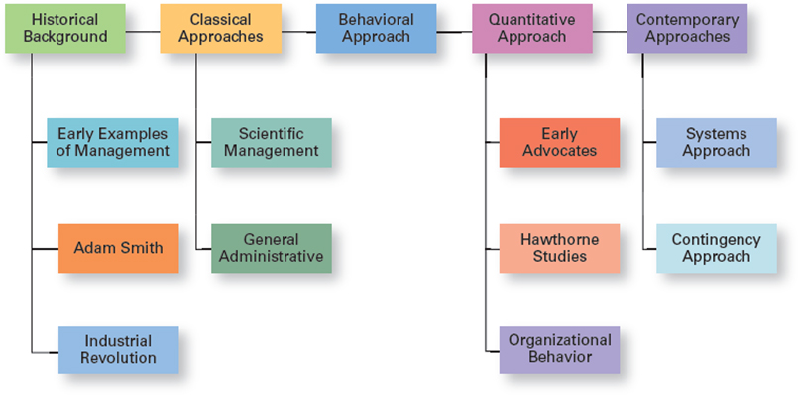
Exhibit MH-1 Major Approaches to Management
© Pearson Education Limited 2016

Slide 8
Classical Approach
1911 – 1947

Slide 9
Classical Approach
First studies of management which emphasized rationality and making organizations and workers as efficient as possible.
Two major theories:
Scientific Management
General Administrative Theory
© Pearson Education Limited 2016

Slide 10
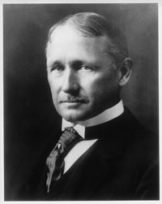
Scientific Management
In 1911, Frederick Winslow Taylor published Principles of Scientific Management.
The theory of scientific management: the use of scientific methods to define the “one best way” for a job to be done.
“father” of scientific management – based on his groundbreaking studies of manual work using scientific principles.
© Pearson Education Limited 2016

Slide 11
Exhibit MH-2 Taylor’s Scientific Management Principles
Taylor defined clear guidelines for improving production efficiency. He argued that these four principles of management would result in prosperity for both workers and managers.
Develop a science for each element of an individual’s work to replace the old rule-of-thumb method.
Scientifically select and then train, teach, and develop the worker.
Heartily cooperate with the workers to ensure that all work is done in accordance with the principles of the science that has been developed.
Divide work and responsibility almost equally between management and workers. Management does all work for which it is better suited than the workers.
© Pearson Education Limited 2016

Slide 12
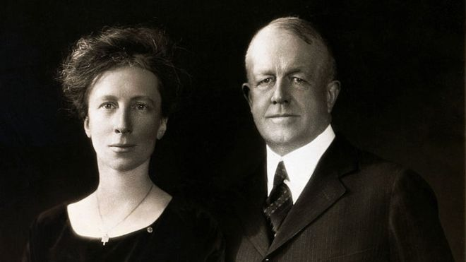
Scientific Management
Frank and Lillian Gilbreth, studied work to eliminate inefficient hand-and body motions.
Invented a device called a micro-chronometer that recorded a worker’s hand-and-body motions and the amount of time spent doing each motion.
Devised a classification scheme to label 17 basic hand motions (such as search, grasp, hold), which they called therbligs.
© Pearson Education Limited 2016

Slide 13
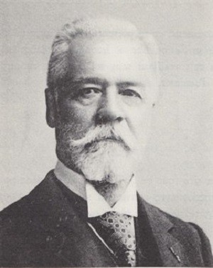
General Administrative Theory
General administrative theory focused more on what managers do and what constituted good management practice.
Henri Fayol believed that management was an activity common to all business endeavors, government, and even the home.
This led him to develop 14 Principles of Management—fundamental rules of management that could be applied to all organizational situations and taught in schools.
© Pearson Education Limited 2016

Slide 14
Exhibit MH-3 Fayol’s 14 Principles of Management
Division of work: Specialization increases output by making employees more efficient.
Authority: Managers must be able to give orders, and authority gives them this right.
Discipline: Employees must obey and respect the rules that govern the organization.
Unity of command: Every employee should receive orders from only one superior.
Unity of direction: The organization should have a single plan of action to guide managers and workers.
Subordination of individual interests to the general interest: The interests of any one employee or group of employees should not take precedence over the interests of the organization as a whole.
Remuneration: Workers must be paid a fair wage for their services.
© Pearson Education Limited 2016

Slide 15
Exhibit MH-3 Fayol’s 14 Principles of Management
Centralization. This term refers to the degree to which subordinates are involved in decision making.
Scalar chain. The line of authority from top management to the lowest ranks is the scalar chain.
Order. People and materials should be in the right place at the right time.
Equity. Managers should be kind and fair to their subordinates.
Stability of tenure of personnel. Management should provide orderly personnel planning and ensure that replacements are available to fill vacancies.
Initiative. Employees allowed to originate and carry out plans will exert high levels of effort.
Esprit de corps. Promoting team spirit will build harmony and unity within the organization.
© Pearson Education Limited 2016

Slide 16
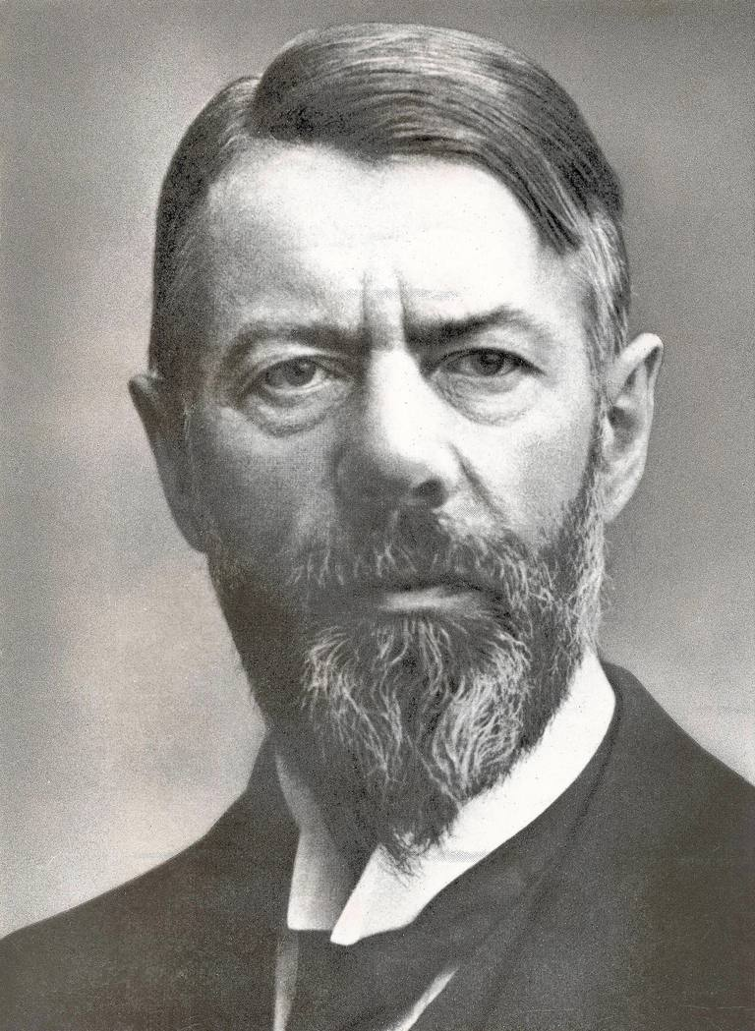
General Administrative Theory
Max Weber was a German sociologist who studied organizations.
He developed a theory of authority structures and relations based on an ideal type of organization he called a bureaucracy – a form of organization characterized by:
division of labor
a clearly defined hierarchy
detailed rules and regulations
and impersonal relationships
© Pearson Education Limited 2016

Slide 17
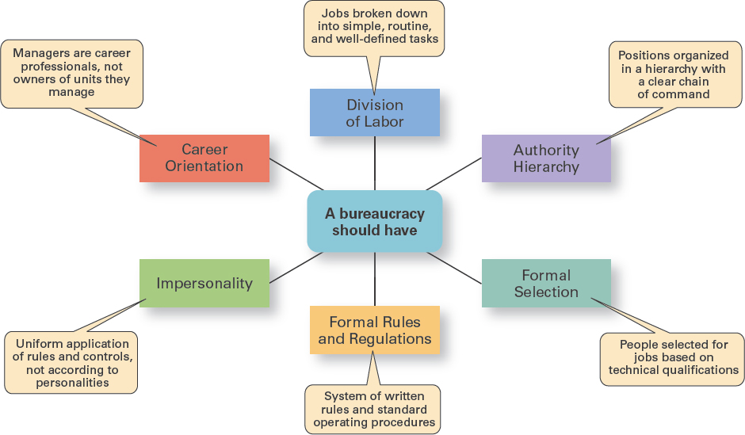
Exhibit MH-4 Characteristics of Weber’s Bureaucracy
© Pearson Education Limited 2016

Slide 18
Behavioral Approach
Late 1700s – 1950s

Slide 19
Organizational Behavior (OB)
The field of study that researches the actions (behavior) of people at work is called organizational behavior (OB).
Much of what managers do today when managing people— motivating, leading, building trust, working with a team, managing conflict, and so forth—has come out of OB research.
Early OB Advocates
Robert Owen
Hugo Munsterberg
Mary Parker Follett
Chester Barnard
© Pearson Education Limited 2016

Slide 20

The Hawthorne Studies
A series of studies during the 1920s and 1930s Western Electric Company Works in Cicero, Illinois that provided new insights into individual and group behavior.
© Pearson Education Limited 2016

Slide 21
The Hawthorne Studies
Experimental findings:
Productivity unexpectedly increased under imposed adverse working conditions.
The effect of incentive plans was less than expected.
Research conclusion:
Social norms, group standards and attitudes more strongly influence individual output and work behavior than do monetary incentives.
© Pearson Education Limited 2016

Slide 22
Quantitative Approach
1940s – 1950s

Slide 23
Quantitative Approach
Use of quantitative techniques to improve decision making.
This approach also is known as management science.
The quantitative approach evolved from mathematical and statistical solutions developed for military problems during World War II. After the war was over, many of these techniques used for military problems were applied.
© Pearson Education Limited 2016

Slide 24
Examples
It involves applying statistics, optimization models, information models, computer simulations, and other quantitative techniques to management activities.
Examples:
Linear programming – a technique that managers use to improve resource allocation decisions.
Critical-path scheduling analysis: use to make efficient work schedules.
Economic order quantity model – helps managers determine optimum inventory levels.
© Pearson Education Limited 2016

Slide 25
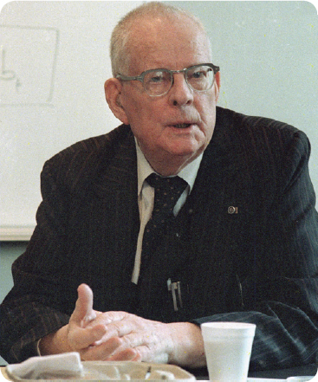
Total Quality Management
Total quality management, or TQM, is a management philosophy devoted to continual improvement and responding to customer needs and expectations.
Early TQM advocates include
W. Edwards Deming
Joseph M. Juran
© Pearson Education Limited 2016

Slide 26
Exhibit MH-6 What Is Quality Management?
1. Intense focus on the customer. The customer includes outsiders who buy the organization’s products or services and internal customers who interact with and serve others in the organization.
2. Concern for continual improvement. Quality management is a commitment to never being satisfied. “Very good” is not good enough. Quality can always be improved.
3. Process focused. Quality management focuses on work processes as the quality of goods and services is continually improved.
4. Improvement in the quality of everything the organization does. This relates to the final product, how the organization handles deliveries, how rapidly it responds to complaints, how politely the phones are answered, and the like.
5. Accurate measurement. Quality management uses statistical techniques to measure every critical variable in the organization’s operations. These are compared against standards to identify problems, trace them to their roots, and eliminate their causes.
6. Empowerment of employees. Quality management involves the people on the line in the improvement process. Teams are widely used in quality management programs as empowerment vehicles for finding and solving problems.
© Pearson Education Limited 2016

Slide 27
Contemporary Approaches
1960s – present

Slide 28
Contemporary Approaches
Starting in the 1960s, management researchers began to look at what was happening in the external environment outside the boundaries of the organization.
Two contemporary management perspectives are part of this approach:
Systems Theory
Contingency Theory
© Pearson Education Limited 2016

Slide 29
Systems Theory
A system is a set of interrelated and interdependent parts arranged in a manner that produces a unified whole.
Closed systems are not influenced by and do not interact with their environment.
Open systems are influenced by and do interact with their environment.
Organizations are describes as open systems. An organization takes in inputs (resources) from the environment and transforms or processes these resources into outputs that are distributed into the environment. The organization is “open” to and interacts with its environment.
© Pearson Education Limited 2016

Slide 30
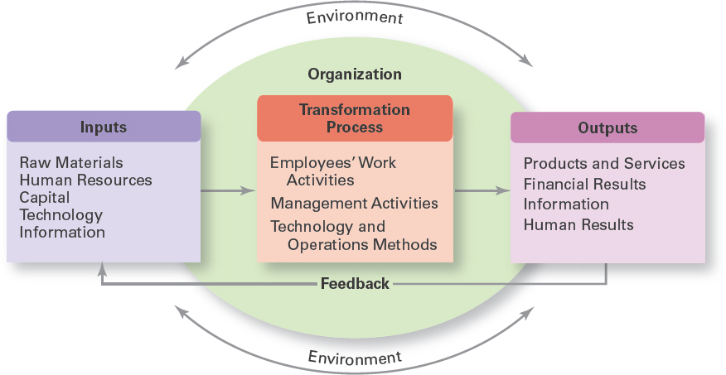
Exhibit MH-7 Organization as an Open System
© Pearson Education Limited 2016

Slide 31
Systems Theory
Managers coordinate work activities in the various parts of the organization, they ensure that all these parts are working together so the organization’s goals can be achieved.
The theory implies that decisions and actions in one organizational area will affect other areas.
It recognizes that organizations are not self-contained. They rely on their environment for essential inputs and as outlets to absorb their outputs. No organization can survive for long if it ignores government regulations, supplier relations, or the varied external constituencies on which it depends.
© Pearson Education Limited 2016

Slide 32
Contingency Approach
The contingency approach (sometimes called the situational approach) says that organizations are different, face different situations (contingencies), and require different ways of managing.
Different and changing situations require managers to use different approaches and techniques.
© Pearson Education Limited 2016

Slide 33
Contingency Approach
If this is the way my situation is, then this is the best way for me to manage in this situation.
It would be surprising to find universally applicable management rules that would work in all situations. But, of course, it’s one thing to say that the way to manage “depends on the situation”.
© Pearson Education Limited 2016

Slide 34
Exhibit MH-8 Popular Contingency Variables
Organization Size. As size increases, so do the problems of coordination. For instance, the type of organization structure appropriate for an organization of 50,000 employees is likely to be inefficient for an organization of 50 employees.
Routineness of Task Technology. To achieve its purpose, an organization uses technology. Routine technologies require organizational structures, leadership styles, and control systems that differ from those required by customized or non-routine technologies.
© Pearson Education Limited 2016

Slide 35
Exhibit MH-8 Popular Contingency Variables
Environmental Uncertainty. The degree of uncertainty caused by environmental changes influences the management process. What works best in a stable and predictable environment may be totally inappropriate in a rapidly changing and unpredictable environment.
Individual Differences. Individuals differ in terms of their desire for growth, autonomy, tolerance of ambiguity, and expectations. These and other individual differences are particularly important when managers select motivation techniques, leadership styles, and job designs.
© Pearson Education Limited 2016

Slide 36
Review Learning Objective MH-1
Describe some early management examples.
Early examples of management practice in the construction of the Egyptian pyramids.
Adam Smith’s Wealth of Nations argued the benefits of division of labor.
In the industrial revolution where it became more economical to manufacture in factories than at home.
© Pearson Education Limited 2016

Slide 37
Review Learning Objective MH-2
Explain the various theories in the classical approach.
Frederick W. Taylor studied manual work using scientific principles.
The Gilbreths’ studied efficient hand-and-body motions.
Fayol believed the functions of management were common to all business endeavors.
Fayol developed 14 principles of management.
Weber described an ideal type of organization he called a bureaucracy.
© Pearson Education Limited 2016

Slide 38
Review Learning Objective MH-3
Discuss the development and uses of the behavioral approach.
Early OB advocates believed that people were the most important asset of the organization and should be managed accordingly.
The Hawthorne Studies dramatically affected management beliefs about the role of people in organizations.
© Pearson Education Limited 2016

Slide 39
Review Learning Objective MH-4
Describe the quantitative approach.
The quantitative approach involves applications of statistics, optimization models, information models, and computer simulations to management activities.
Total quality management—a management philosophy devoted to continual improvement and responding to customer needs and expectations—also makes use of quantitative methods to meet its goals.
© Pearson Education Limited 2016

Slide 40
Review Learning Objective MH-5
Explain the various theories in the contemporary approach.
The systems approach says that an organization takes in inputs (resources) from the environment and transforms them into outputs that are distributed into the environment.
The contingency approach says that organizations are different, face different situations, and require different ways of managing.
© Pearson Education Limited 2016

